Slide 1
Peer-graded Assignment: Capstone Project - The Battle of Neighborhoods (Week 2)
By
M. Shehata

Slide 2
Introduction:
We will test whether the Japanese and Sushi Restaurants are clustered in the neighborhoods of Los Angeles (LA) around bars. Also, we will check if happens in certain LA region. If this is true, the location of nearby bars is important when deciding the location of new Japanese restaurants. This will be compared with clustering around other restaurants (which is expected to be true) or any other venue (which is not expected to be true as this is random).
Data:
I have extracted the neighborhoods of Los Angeles (LA) and get those with the most Japanese or Sushi restaurants (hereafter, JPLA).
Methodology:
I have created averaged number of venues per neighborhood for bars, other restaurants, or other venues in general named bar index (test), restaurant index (positive control), other index (negative control). I used Kmeans to cluster JPLA based on these indexes. The mean value for index per cluster and per region is calculated. I used One-way ANOVA for statistical analysis.

Slide 3
Results:
When I clustered the JPLA neighborhoods into 4 clusters (Fig. 1 and 2), only one cluster (cluster 3) showed higher bar index compared to other clusters (Table 1).
Also, in this cluster the bar index was significantly above the other index (One-way ANOVA, p = 0.003) (Fig. 3). Neighborhoods in this cluster are from different regions in LA (Table 2).
In all clusters, the restaurant index was significantly higher than other indexes (One-way ANOVA, P = 0.0096) (Fig. 4).

Slide 4
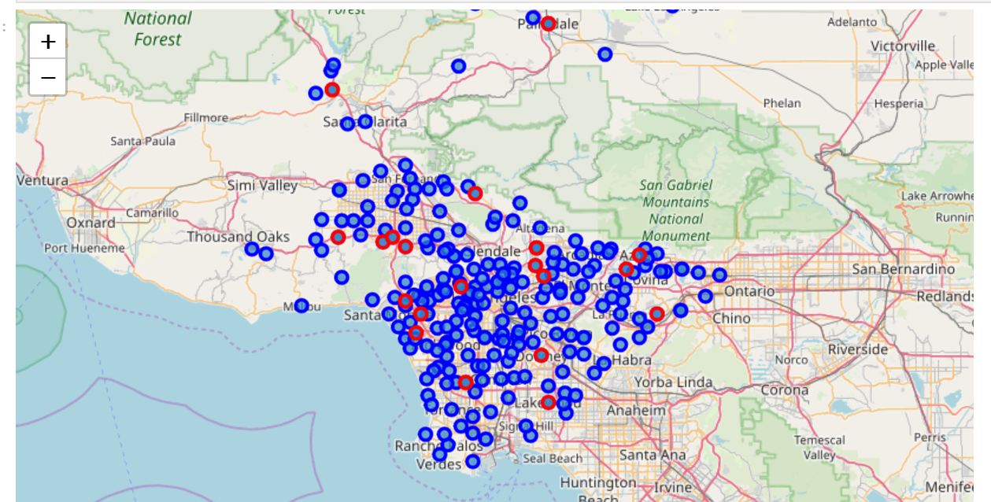
Fig 1: LA neighborhoods with most Japanese or Suchi restaurants

Slide 5
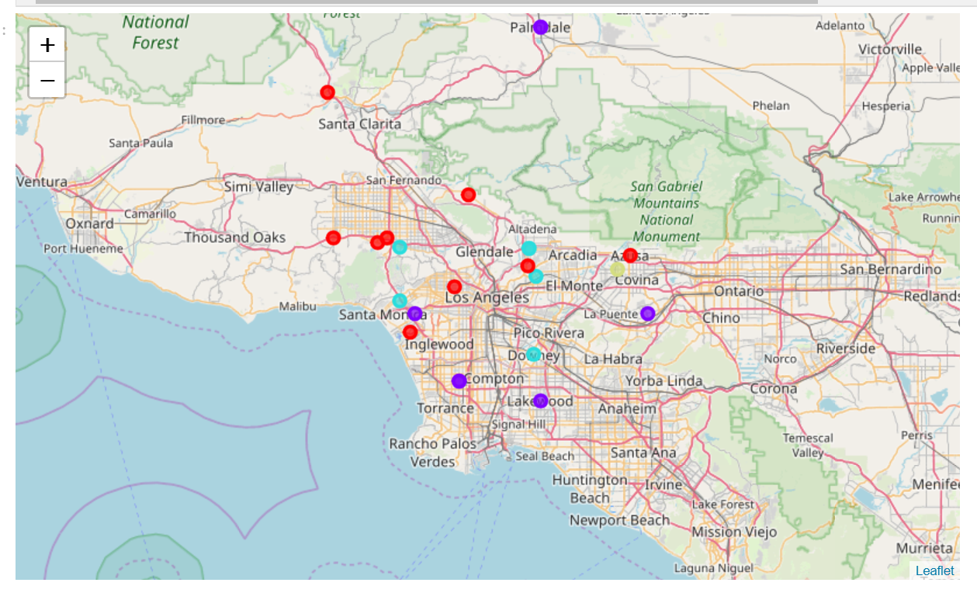
Fig. 2: LA neighborhoods with most Japanese or Suchi restaurants
Clustered

Slide 6
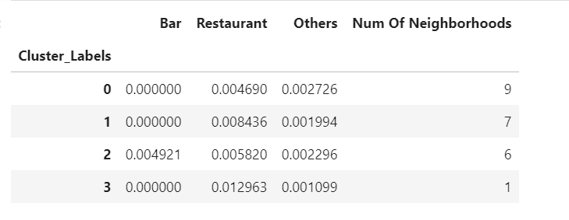
Table 1: Characteristics of all clusters

Slide 7
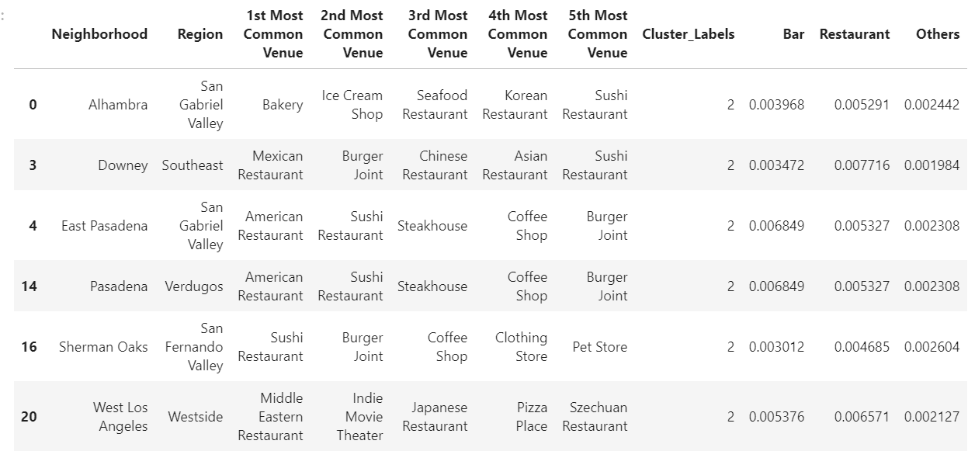
Table 2: Cluster 2 characteristics

Slide 8
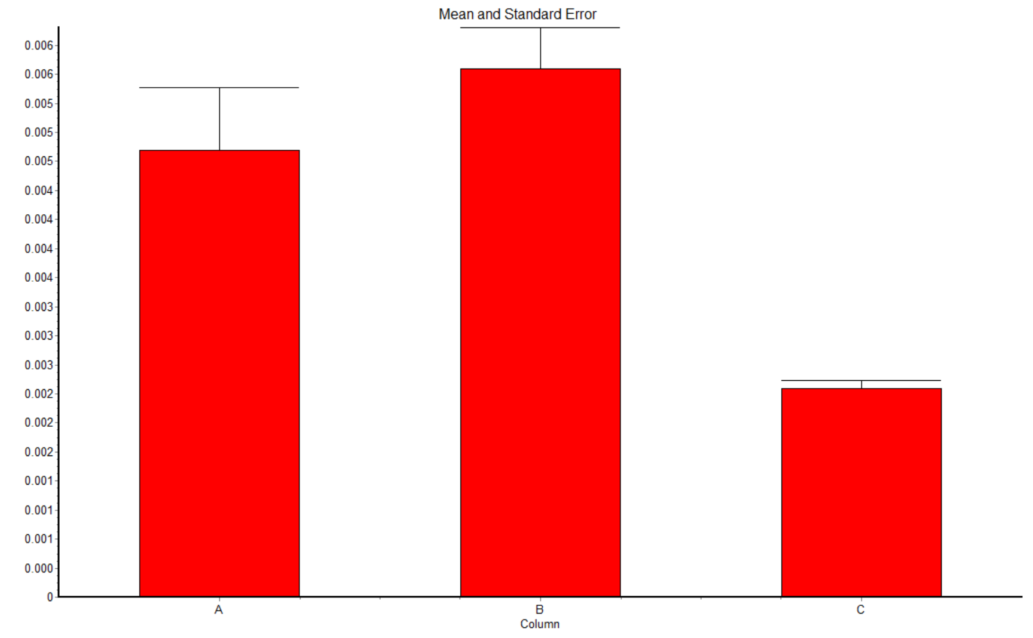
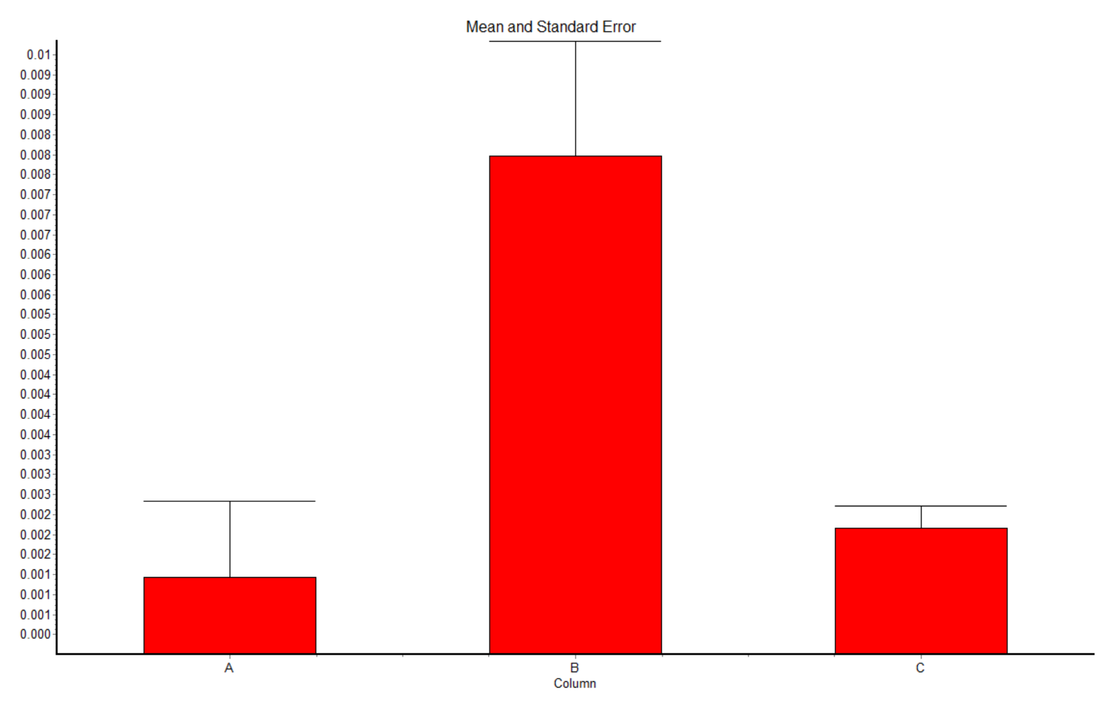
Fig. 3: Cluster 2
Fig. 4: all Clusters
P < 0.05
P < 0.05
Bar index Restaurant index Other index
Bar index Restaurant index Other index

Slide 9
Discussion:
In some neighborhoods (check names in cluster 2), the Japanese and Sushi restaurants cluster around bars. However, this is not the general trend. As expected, the Japanese and Sushi restaurants cluster around other restaurants.
Conclusion:
The notion that the Japanese and Sushi restaurants cluster around bars is not a rare trend in LA county. There is no need to consider nearby bar locations to decide a Japanese restaurant location.

